Slide 1
A1 Chemistry
Metallic Bonding

Slide 3
Learning INtentions
chemical bonds are caused by electrostatic attractions that arise because of the sharing or transfer of electrons between participating atoms; the valency is a measure of the bonding capacity of an atom
the ability of atoms to form chemical bonds can be explained by the arrangement of electrons in the atom and in particular by the stability of the valence electron shell
the type of bonding within ionic, metallic and covalent substances explains their physical properties, including melting and boiling points, conductivity of both electricity and heat and hardness
metallic bonding can be modelled as a regular arrangement of atoms with electrostatic forces of attraction between the nuclei of these atoms and their delocalised electrons that are able to move within the three dimensional lattice
the metallic bonding model can be used to explain the properties of metals, including malleability, thermal conductivity, generally high melting point and electrical conductivity; covalent bonding can be modelled as the sharing of pairs of electrons resulting in electrostatic forces of attraction between the shared electrons and the nuclei of adjacent atoms

Slide 4
Success Criteria
Define valency and explain that it affects bonding capacity and therefore type of bonding that elements can undergo
List and explain properties of metals, by explaining bonding arrangements
Draw diagrams to represent how bonding arrangements cause physical properties of metals

Slide 5
Key words
electrostatic
valence
metallic
lattice
delocalised
malleable
ductile

Slide 6
Bonding
The type of bonding that forms between atoms is determined by their valence
Valence is the how ‘full’ the outer electron shell is
The more electrons in an outer shell, the more strongly the electrons are held.
The three main types of bonding that occur between atoms are metallic, ionic and covalent.

Slide 7
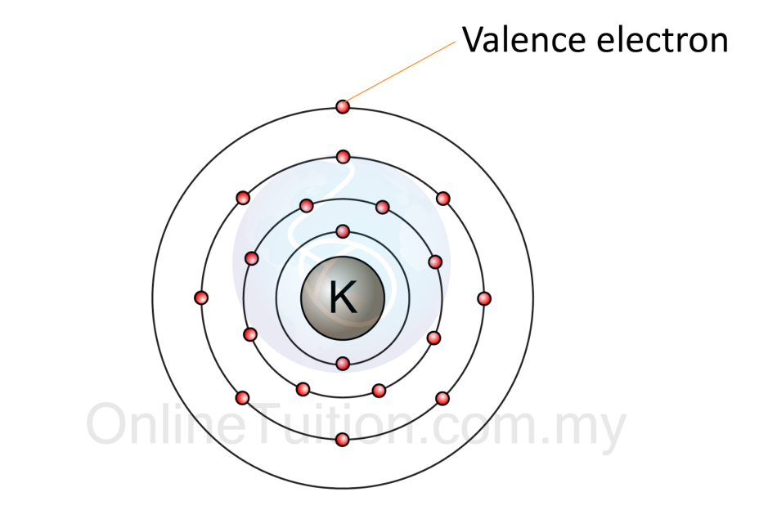
metal valence
Metals have low valence – their outer shells are relatively empty and their outer electrons are weakly held.

Slide 8
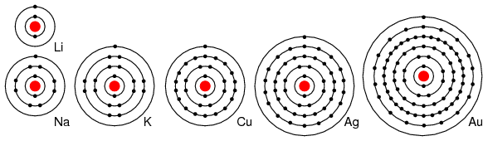

Slide 9
metallic bonding
Metal atoms are densely packed together, usually in a neat 3D arrangement*
The outer shell electrons tend to be equally attracted to any atom – they are ‘delocalised’ and can move easily within the lattice of atoms

Slide 10
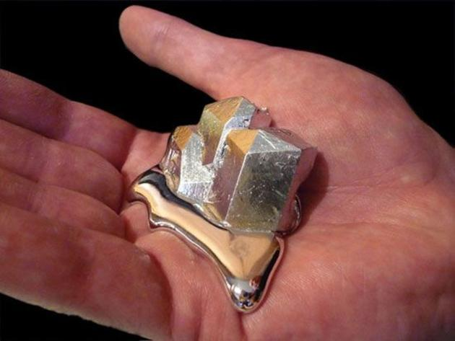
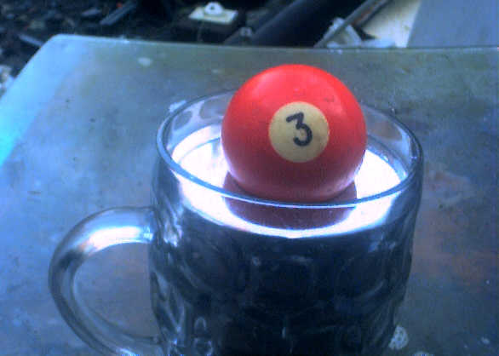
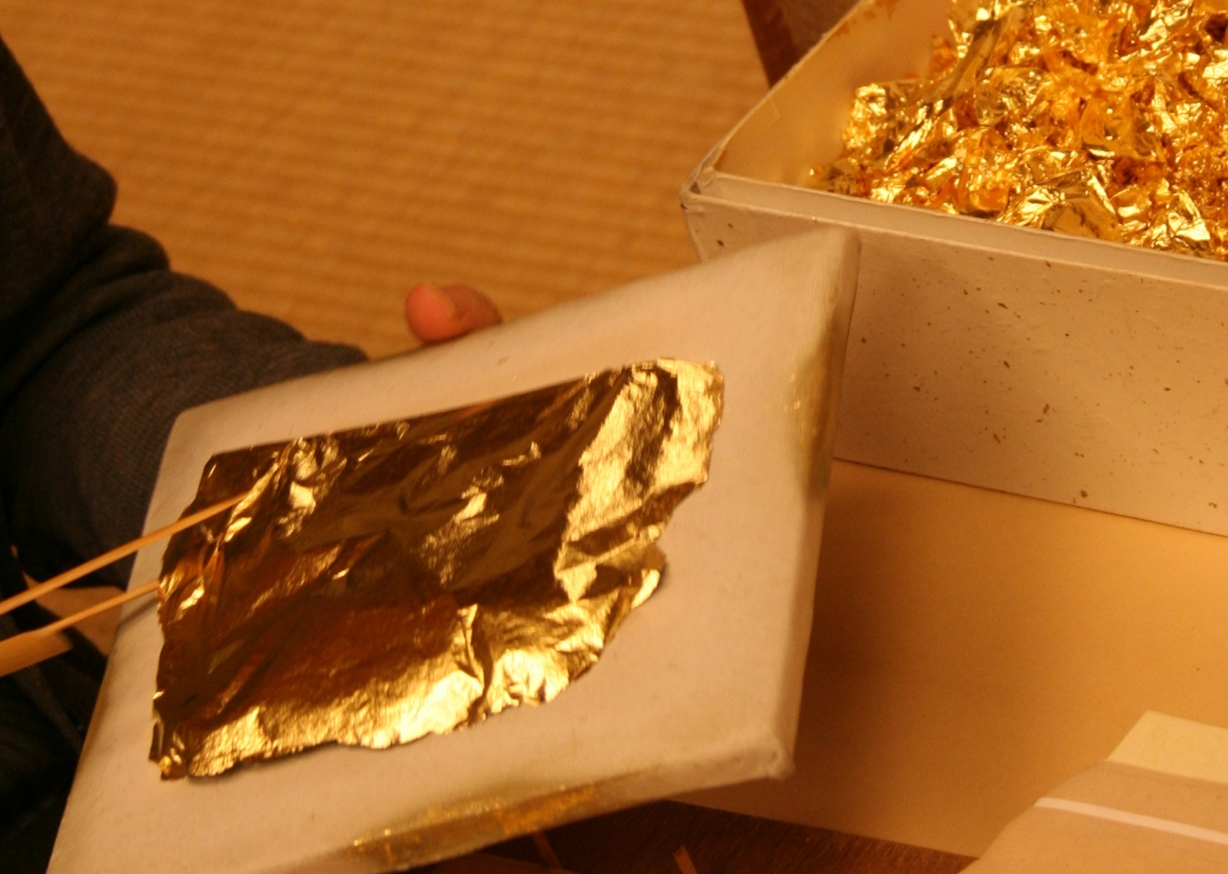
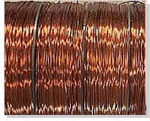

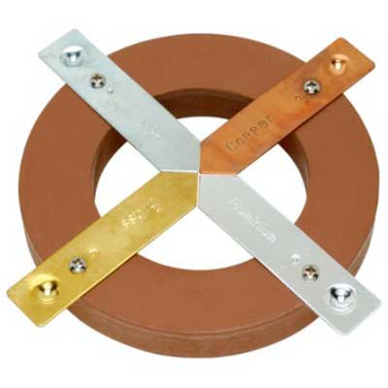
properties of metals
Moderate melting and boiling point (usually solid at room temperature)
Dense
Good thermal conductors
Good electrical conductors
“Shiny” lustre
Malleable
Ductile

Slide 11
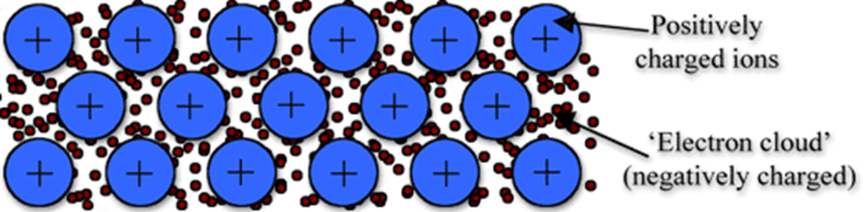
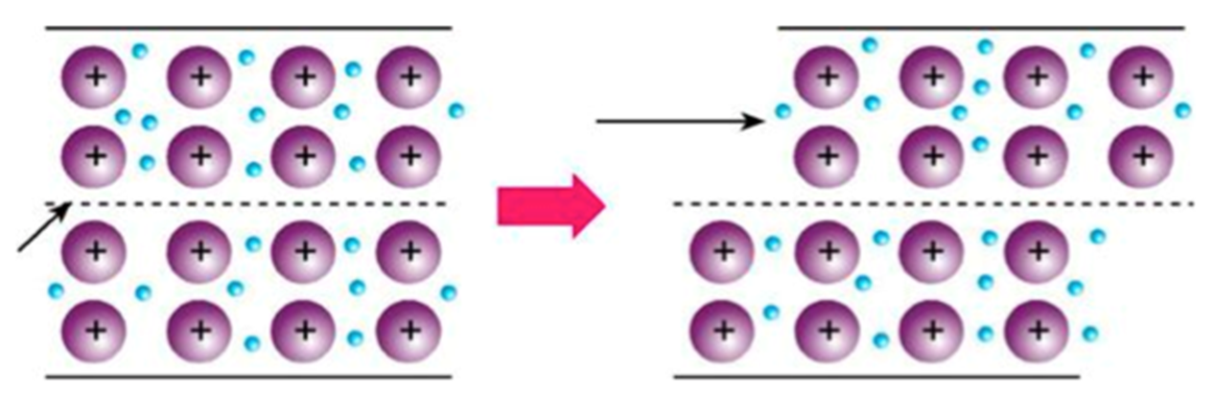
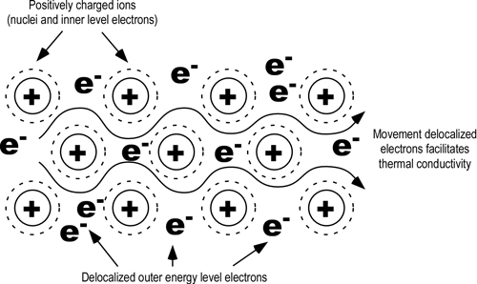

Slide 12
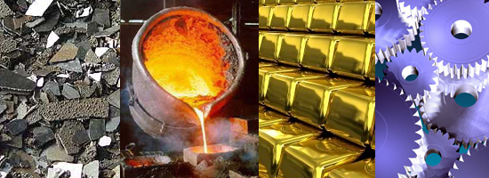

Slide 13
Success Criteria
Define valency and explain that it affects bonding capacity and therefore type of bonding that elements can undergo
List and explain properties of metals, by explaining bonding arrangements
Draw diagrams to represent how bonding arrangements cause physical properties of metals

